Slide 1
Adversarial Attack on Image Classifiers and Distillation as its Defence
Presented By-
Gourab Saha (RollNo. C23012)
Kaustabh Das (RollNo. C23015)
Md Shayan Shafique (RollNo. C23018)
Sayanik Mukherjee (RollNo. C23027)
Tushar Gupta (RollNo. C23038)

Slide 2
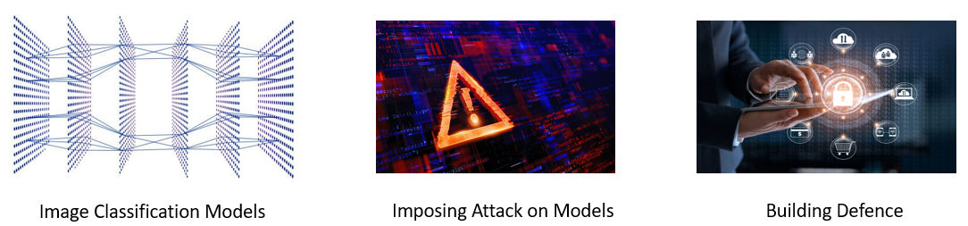
Objective
CNNs are vulnerable to adversarial perturbations
Due to adversarial attack, it is impossible to distinguish perturbed image from the original image by human eyes
This work also suggests defensive strategy known as defensive distillation, to diminish the impact of adversarial samples.

Slide 3
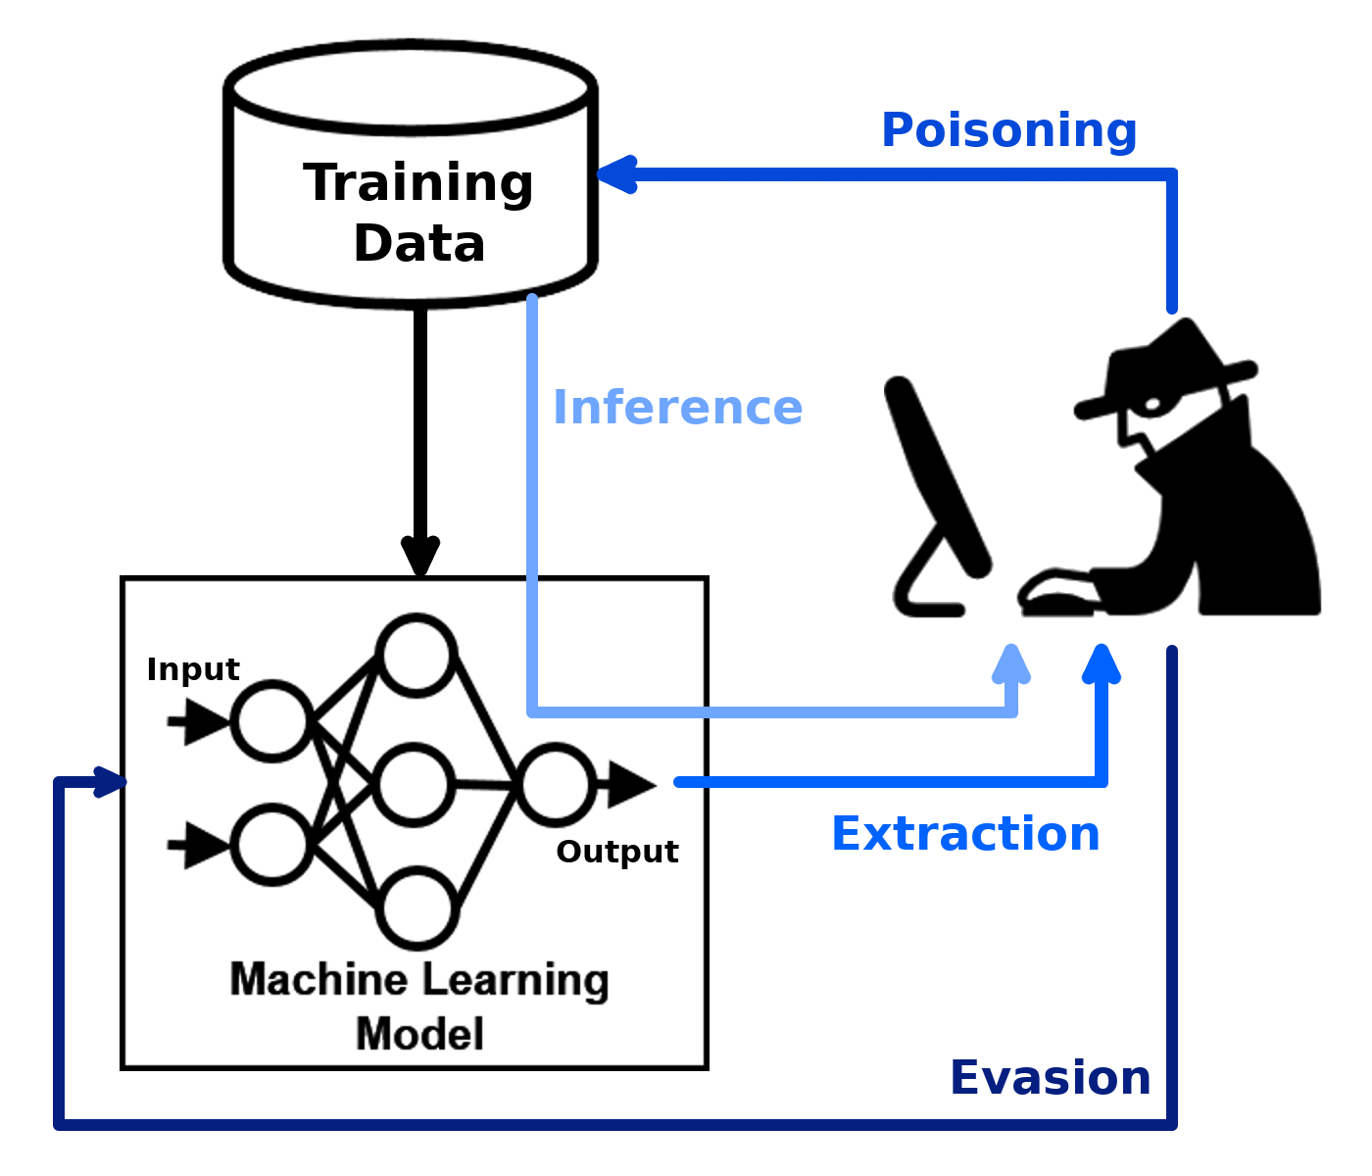
Contents
Introduction to CNN
Example of Adversarial Images
Introduction to FGSM
Targeted and Non-targeted Attack
Introduction to Black-Box attack
Example of Patch Attack
Impact on Transfer Learning
Defence against Adversarial Attack
Future Scope

Slide 4
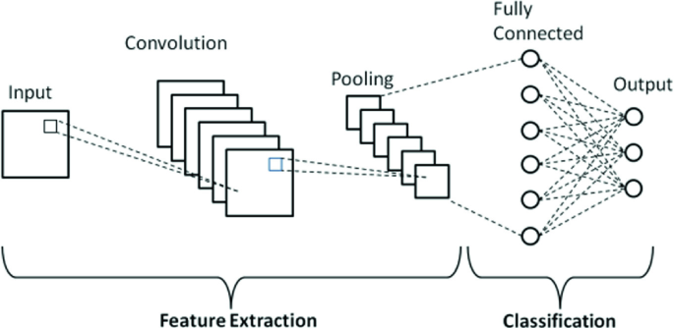
CNN: widely used!

Slide 5
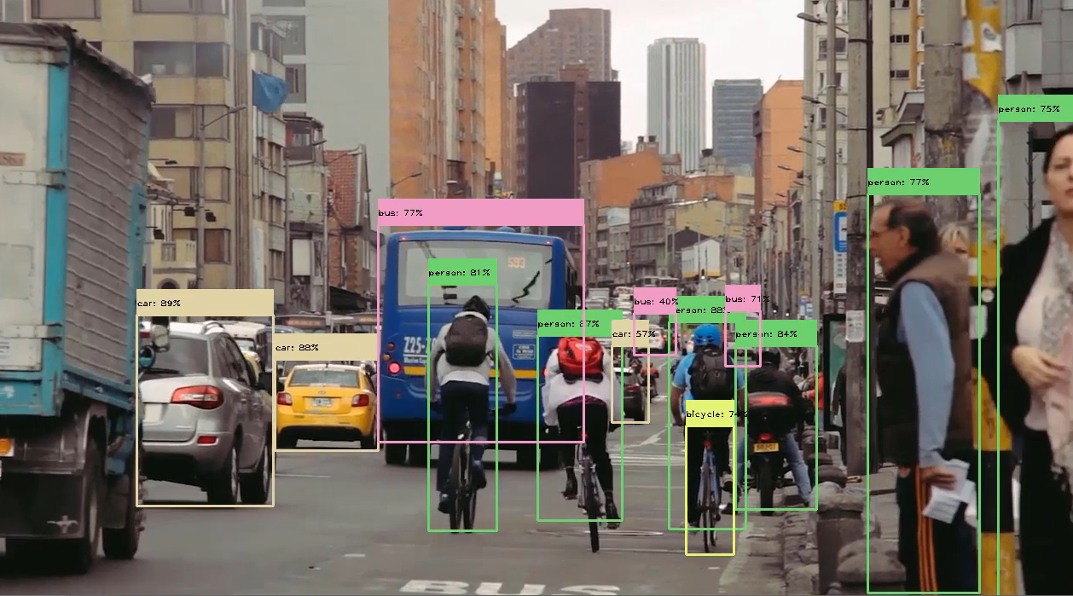
Why CNN?
Fascinating Accuracy
Several Business Applications:
Image recognition
Object detection for
self-driving cars
Image analysis in healthcare
Face recognition / Biometric
recognition etc.

Slide 6

Is CNN really robust?
What if some perturbed image is fed to classifier?
Can CNN still classify them correctly with reasonable accuracy?

Slide 7
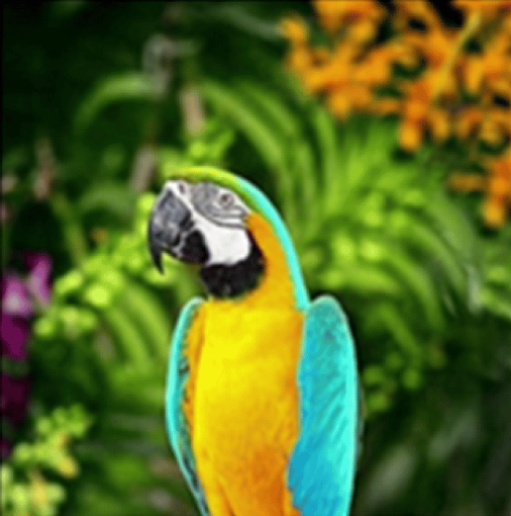
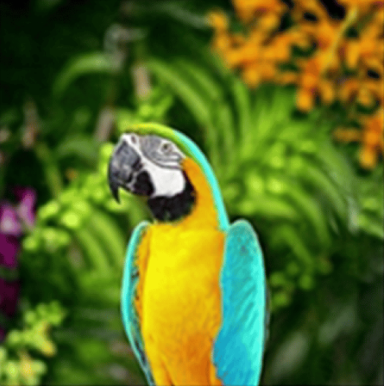
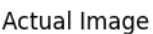
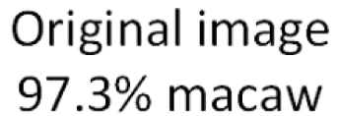
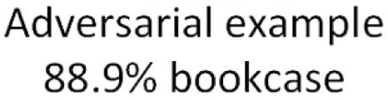
Adversarial Example:
adversarial
perturbation

Slide 8
Why it happens?
Fast Gradient Sign Method (FGSM)
Also known as Algorithmic attack
This attack method can be divided into two categories:
FGSM
Non-targeted FGSM
Targeted FGSM

Slide 9
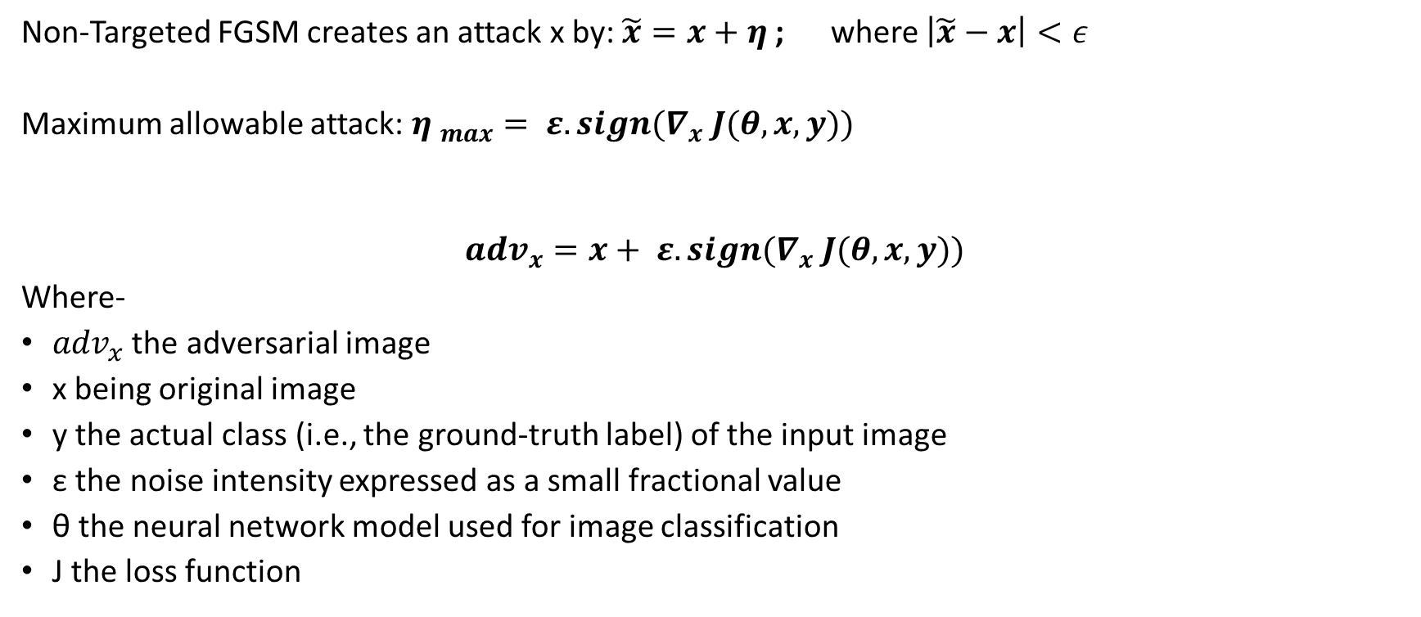
Non-Targeted FGSM:
Non-Targeted FGSM creates an attack x by: $\tilde{x}=x+η$ ; where $\left|\tilde{x}−x\right|<ε$
Maximum allowable attack: ${η }_{max}= ε.sign(∇_{x} J(θ,x,y))$
$${adv}_{x}=x+ ε.sign(∇_{x} J(θ,x,y))$$
Where-
${adv}_{x}$ the adversarial image
x being original image
y the actual class (i.e., the ground-truth label) of the input image
ε the noise intensity expressed as a small fractional value
θ the neural network model used for image classification
J the loss function

Slide 10
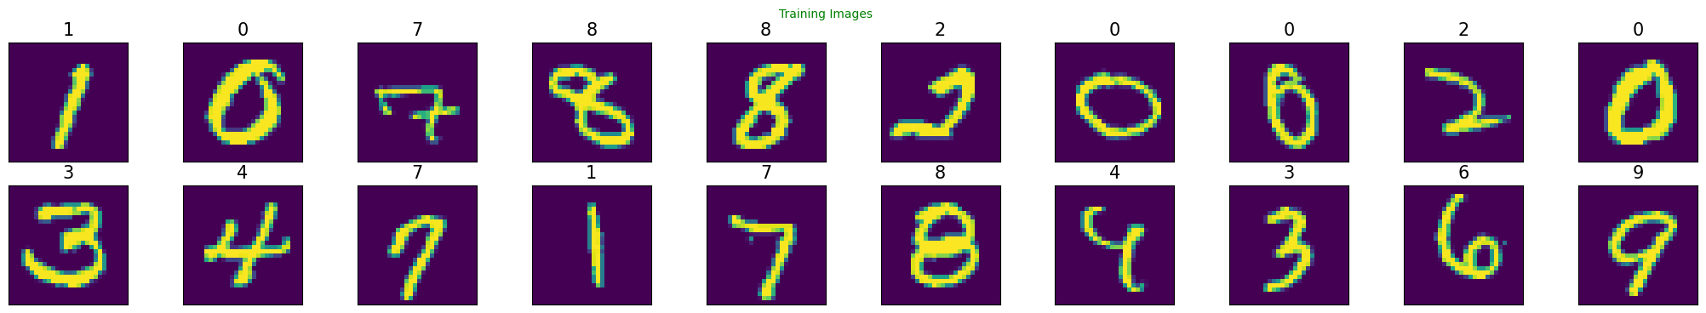
Non-Targeted Attack Example:01
Lets consider MNIST dataset (contains handwritten digits: grey scale)
Target Classes: 10 (0-9)
Model used: LeNet Architecture

Slide 11
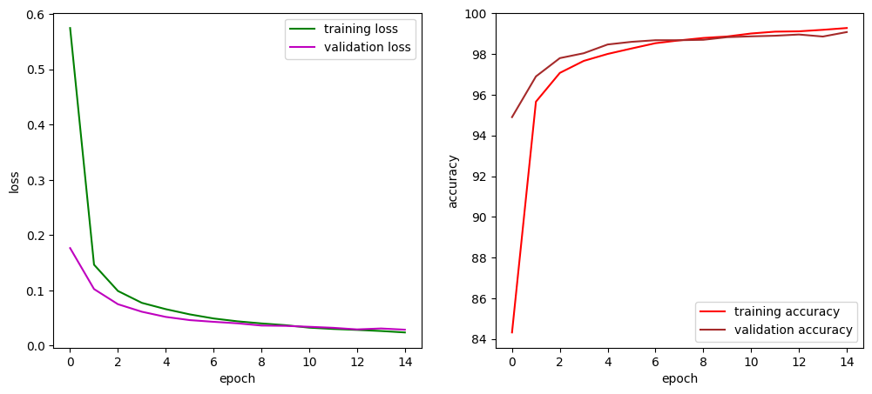
Example-01 contd.
After 15 epochs; we have achieved:

Slide 12
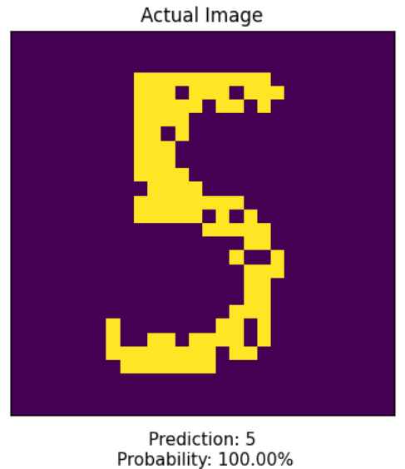
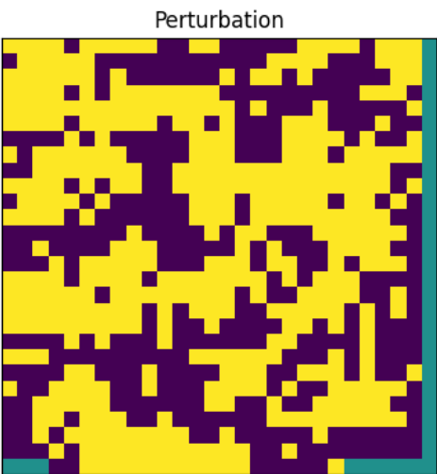
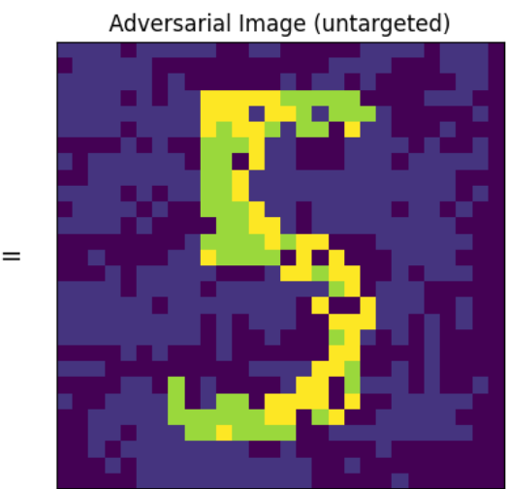
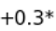
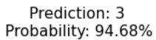
Example-01 (gray scale image) contd.

Slide 13
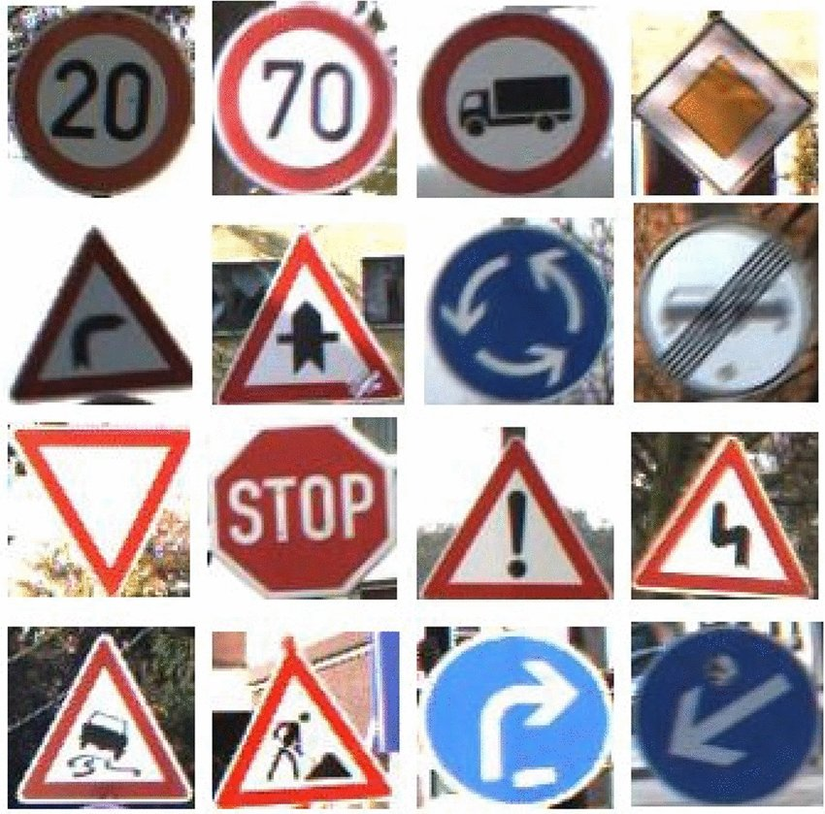
Non-Targeted FGSM Example:02
Now consider GTSRB dataset (German Traffic Sign Recognition Benchmark)
Contains RGB images
Target Classes: 43
Used AlexNet with
Transfer Learning

Slide 14
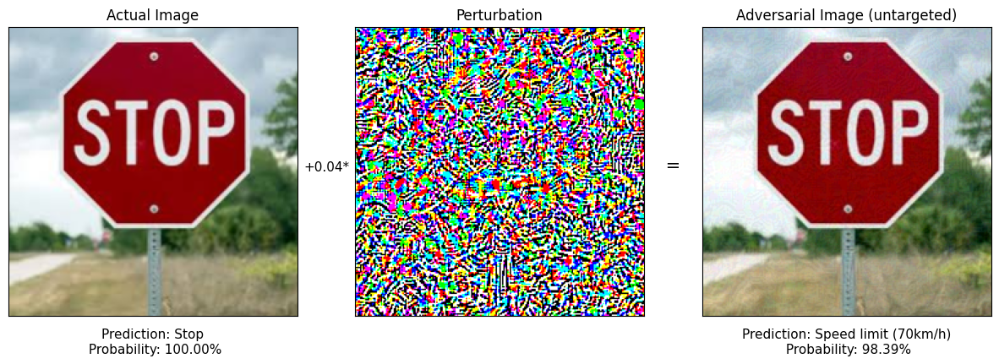
Example-02 (RGB image) contd.

Slide 15
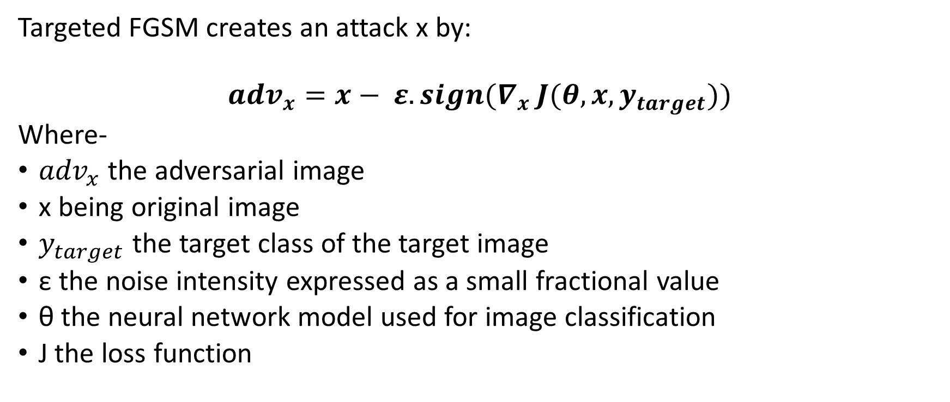
Targeted FGSM:
Targeted FGSM creates an attack x by:
$${adv}_{x}=x− ε.sign(∇_{x} J(θ,x,y_{target}))$$
Where-
${adv}_{x}$ the adversarial image
x being original image
$y_{target}$the target class of the target image
ε the noise intensity expressed as a small fractional value
θ the neural network model used for image classification
J the loss function

Slide 16
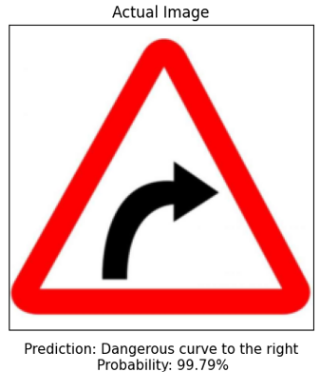
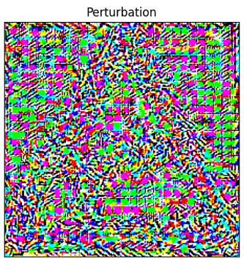
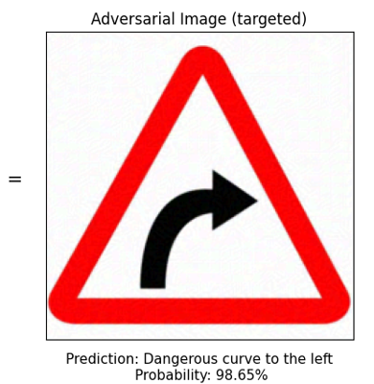
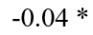
Targeted FGSM Example:01
Dataset: GTSRB

Slide 17
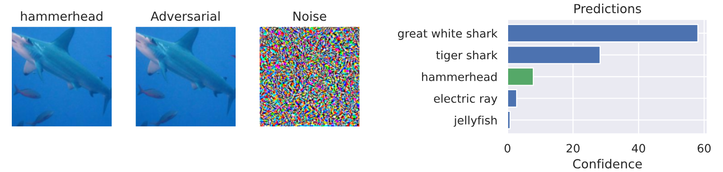
Example-02 (RGB image) contd.
Lets understand about top-1 vs. top5 classification:

Slide 18
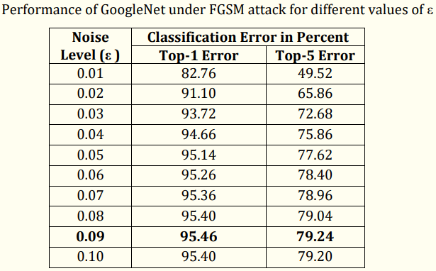
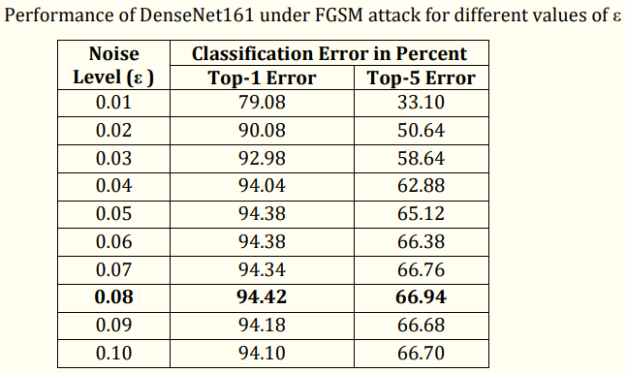
Adversarial Impact Analysis on Pretrained Models:
FGSM Attack:

Slide 19
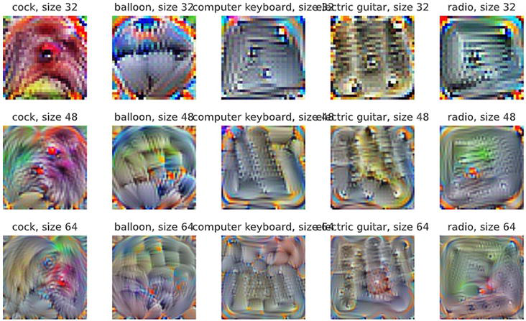
Patch Attack:
It’s a black box attack
The strategy is to transform a small portion of the image into a desired form and shape instead of the FGSM's approach of slightly altering some pixels.

Slide 20
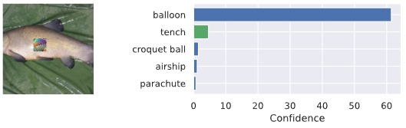
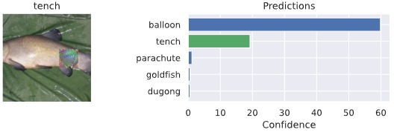
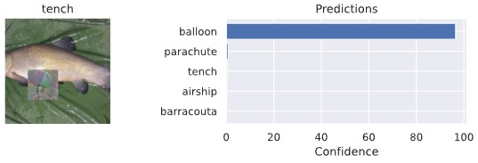
Patch Attack Examples:
Patch Image Size of 32*32
Patch Image Size of 48*48
Patch Image Size of 64*64

Slide 21
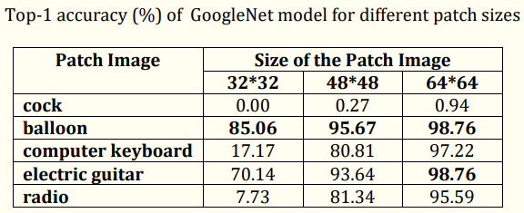
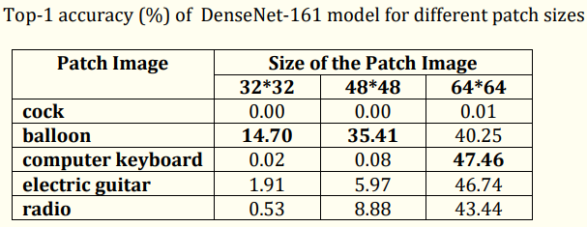
Adversarial Impact Analysis on Pretrained Models:
Patch Attack:

Slide 22
Defence Against Adversarial Attack:
Easy solution is: Adversarial Training
But feeding all possible adversarial images will be too cumbersome for model & also too much complex
Another Solution is: Defensive Distillation
This approach uses concept of Knowledge distillation between a Teacher Network & Student Network

Slide 23
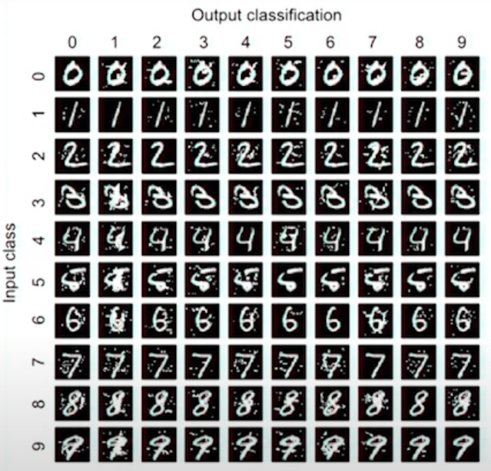
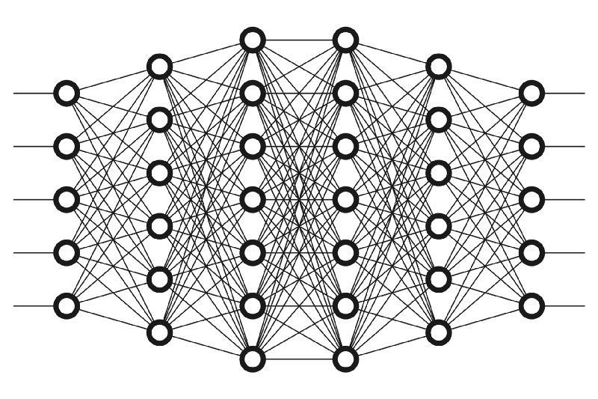
Defensive Distillation
Teacher Model (complex in nature)

Slide 24
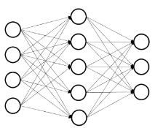
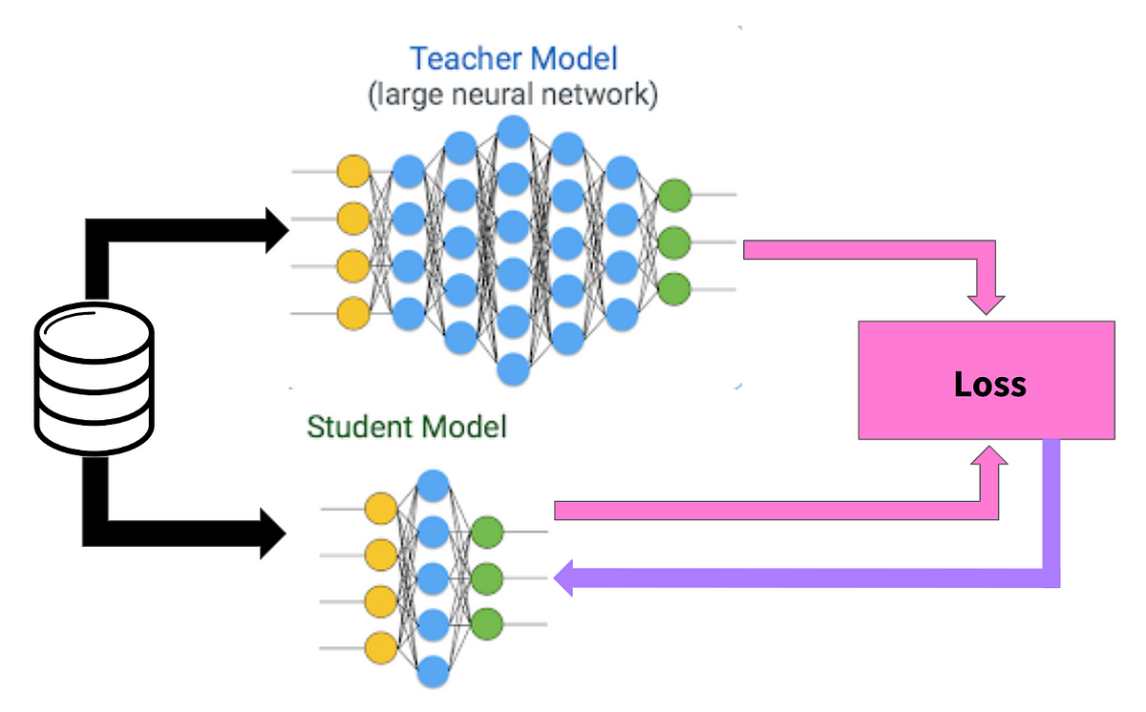
Working of Defensive Distillation
Student Model

Slide 25
Working of Defensive Distillation
Teacher Model
(can be pretrained)
SoftMax
(t = T)
Soft Labels
Image Set
Distillation Loss
(can be Cross Entropy / KL Divergence)
Student Model
SoftMax
(t = T)
Soft Predictions
SoftMax
(t = 1)
Soft Predictions
final layer logit values
Student Loss
(can be Cross Entropy / KL Divergence)
Soft Labels
Loss = $α∗Student Loss+(1−α$) * Distillation Loss

Slide 26
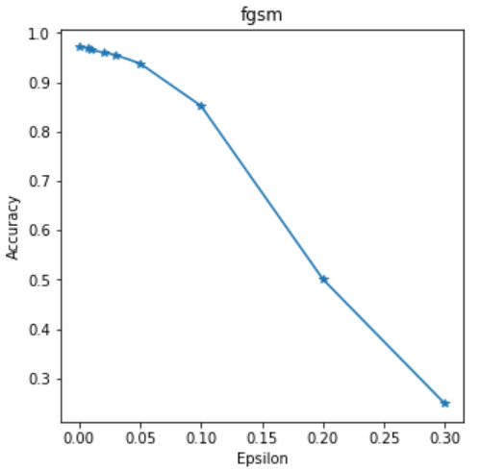
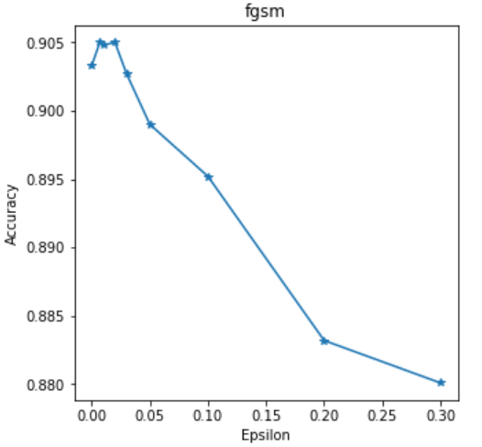
Results Obtained After Defence Strategy
Before Defence
After Defence

Slide 27
Advantage of Defensive Distillation
Defensive Distillation smooths the model’s decision surface in adversarial directions exploited by the adversary.
This approach is more dynamic and requires less human intervention
Distillation approach is adaptable to unknown threats

Slide 28
Summary
Discussed about White-Box and Black-Box attacks on image classifiers
Impact analysis on pretrained models
Defence against FGSM attack
Any autonomous detection system which uses Neural Network is vulnerable to this attack.
There is one more severe attack: Carlini and Wagner’s adversarial attack (aka CW attack)
Unfortunately, till now there is no defence for that attack!!

Slide 29
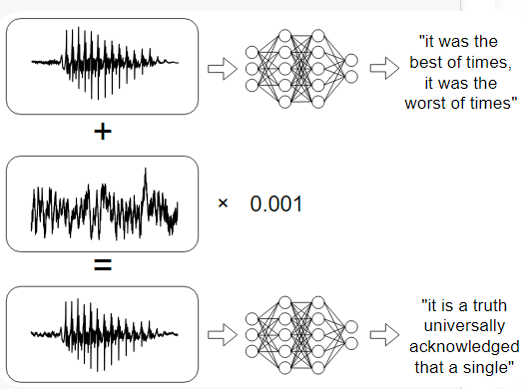
Future Scope
Speech Synthesising based Attack

Slide 30


